Slide 1
Stock Price Prediction
Name: Yashodeep Narendra Sonar
UNID: UMIP273074

Slide 2
Agenda
Introduction
Technologies & Libraries Used
Data Collection
Data Preparation
Exploratory Data Analysis (EDA)
Correlation Analysis
Feature Engineering
Data Standardization
Model Training & Evaluation
Results & Conclusions
Future Scope

Slide 3
Introduction
The project analyzes stock prices of Apple, Microsoft, Netflix, and Google over the last three months.
Objective: Identify trends, assess volatility, and predict stock prices using machine learning.
Techniques Used:
Exploratory Data Analysis (EDA)
Feature Engineering
Correlation Analysis
Machine Learning Model Training & Evaluation

Slide 4
Technologies & Libraries Used
Programming & Tools: Python, Excel
Libraries:
pandas – Data Manipulation
numpy – Numerical Computations
matplotlib & seaborn – Data Visualization
scikit-learn – Machine Learning

Slide 5
Data Collection
The dataset contains historical stock data for Apple, Microsoft, Netflix, and Google.
Key Data Features:
Date
Open Price
High Price
Low Price
Close Price
Adjusted Close Price
Trading Volume

Slide 6
Data Preparation
Handling Missing Data:
Date Conversion:
One-Hot Encoding:
Remove empty or corrupted records.
Convert date values into a time-series format.
Convert categorical data (stock tickers) into numerical format.

Slide 7
Exploratory Data Analysis (EDA)

Slide 8
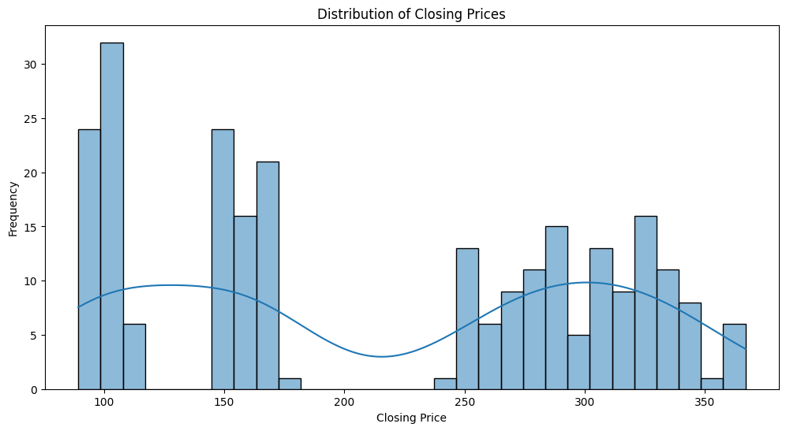
Histogram Analysis:
Histogram Analysis :
Helps understand stock price distribution.
Identifies trends and price fluctuations.
Volatility Analysis:
Determines the variation in stock prices over time.

Slide 9
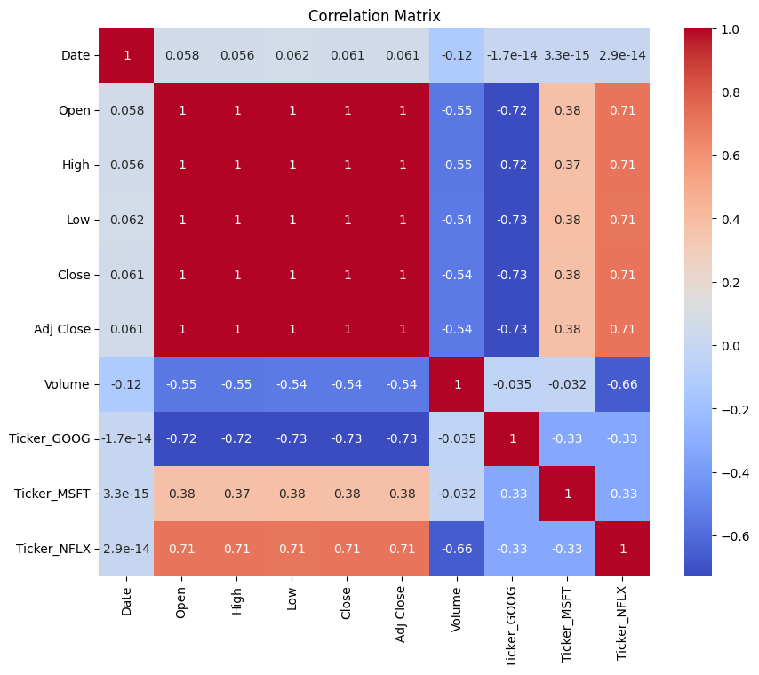
Correlation Analysis
Purpose: Identify relationships between stock prices of different companies.
Key Findings :
Companies within the same industry often show high correlation.
Stock movements of tech companies (Apple, Microsoft, Google) are closely linked.

Slide 10
Feature Engineering
Separating Features & Target Variables :
Features: Open, High, Low, Volume
Target: Closing Price
Creating Moving Averages :
Helps smooth out price fluctuations for better trend analysis.

Slide 11
Data Standardization
Why Standardization?
Ensures all features have the same scale.
Prevents one feature from dominating the model.
Scaling Techniques Used :
Standard Scaler – Normalizes feature values.

Slide 12
Model Training & Evaluation
Train-Test Split | Machine Learning Model Used | Performance Metrics
80% Data → Training 20% Data → Testing | Random Forest Regressor : Handles stock price prediction efficiently. | Mean Squared Error (MSE) – Measures prediction accuracy.

Slide 13
Results & Conclusions
Model Performance :
MSE = 1.05 (Lower value = Better accuracy)
Key Insights :
Stock prices show seasonal trends.
Random Forest performed well, but improvements are possible

Slide 14
Future Scope
Neural Networks & Deep Learning :
Implement LSTM (Long Short-Term Memory) for time-series forecasting.
Real-Time Data Analysis :
Fetch live stock prices using APIs for better predictions.
Sentiment Analysis :
Analyze social media/news impact on stock prices.

Slide 15
References
Deep Learning-Based Stock Price Prediction Using LSTM and Bi-Directional LSTM Model.
A Deep Learning-Based LSTM for Stock Price Prediction Using Twitter Sentiment Analysis.
Deep Learning Based Stock Price Prediction with Bollinger Band, RSI, MACD, and OHLC Features.
LSTM-based Deep Learning Model for Stock Prediction and Predictive Optimization Model.

Slide 16
Thank you

